Slide 1
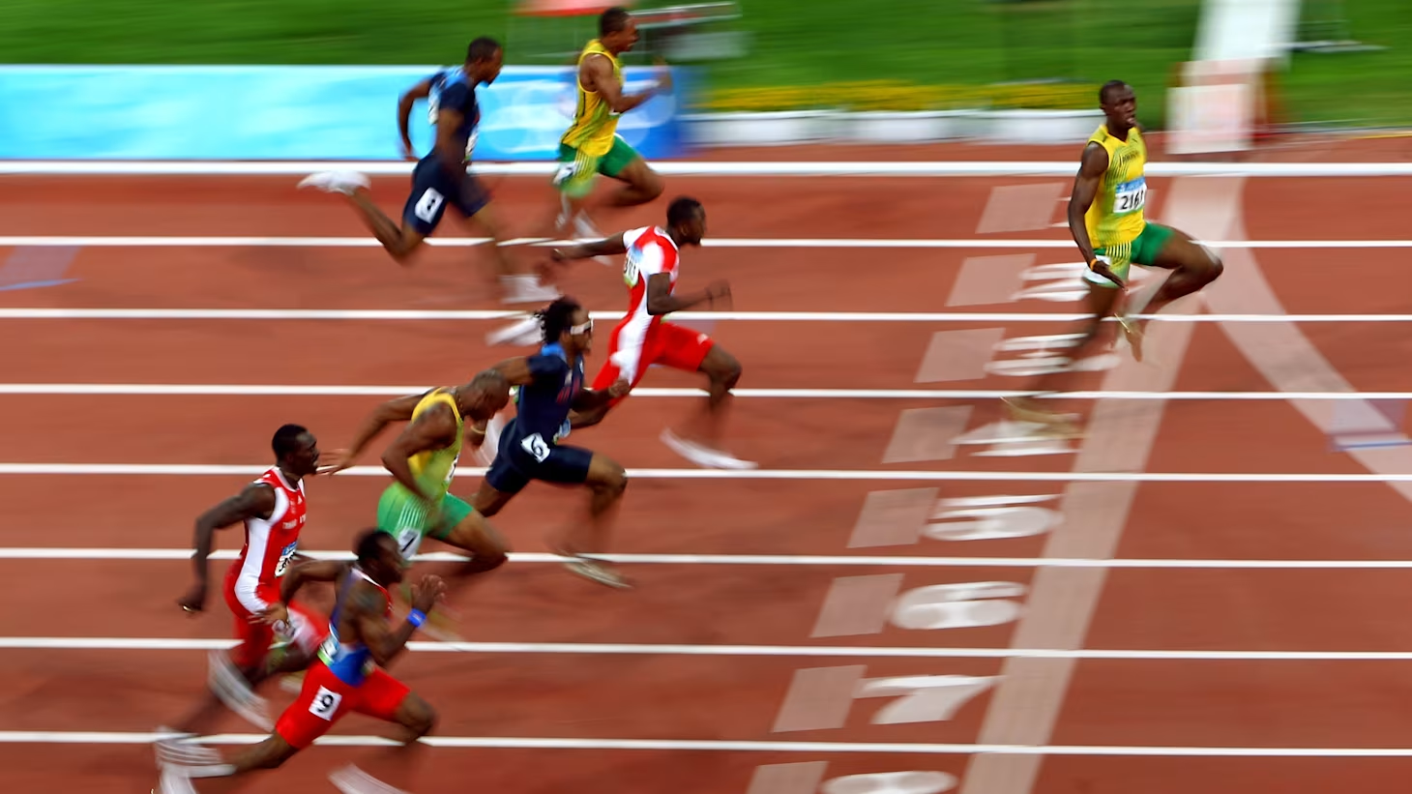

VR OPTIMIZATION
Your vr app
By Henry Bryant

Slide 2

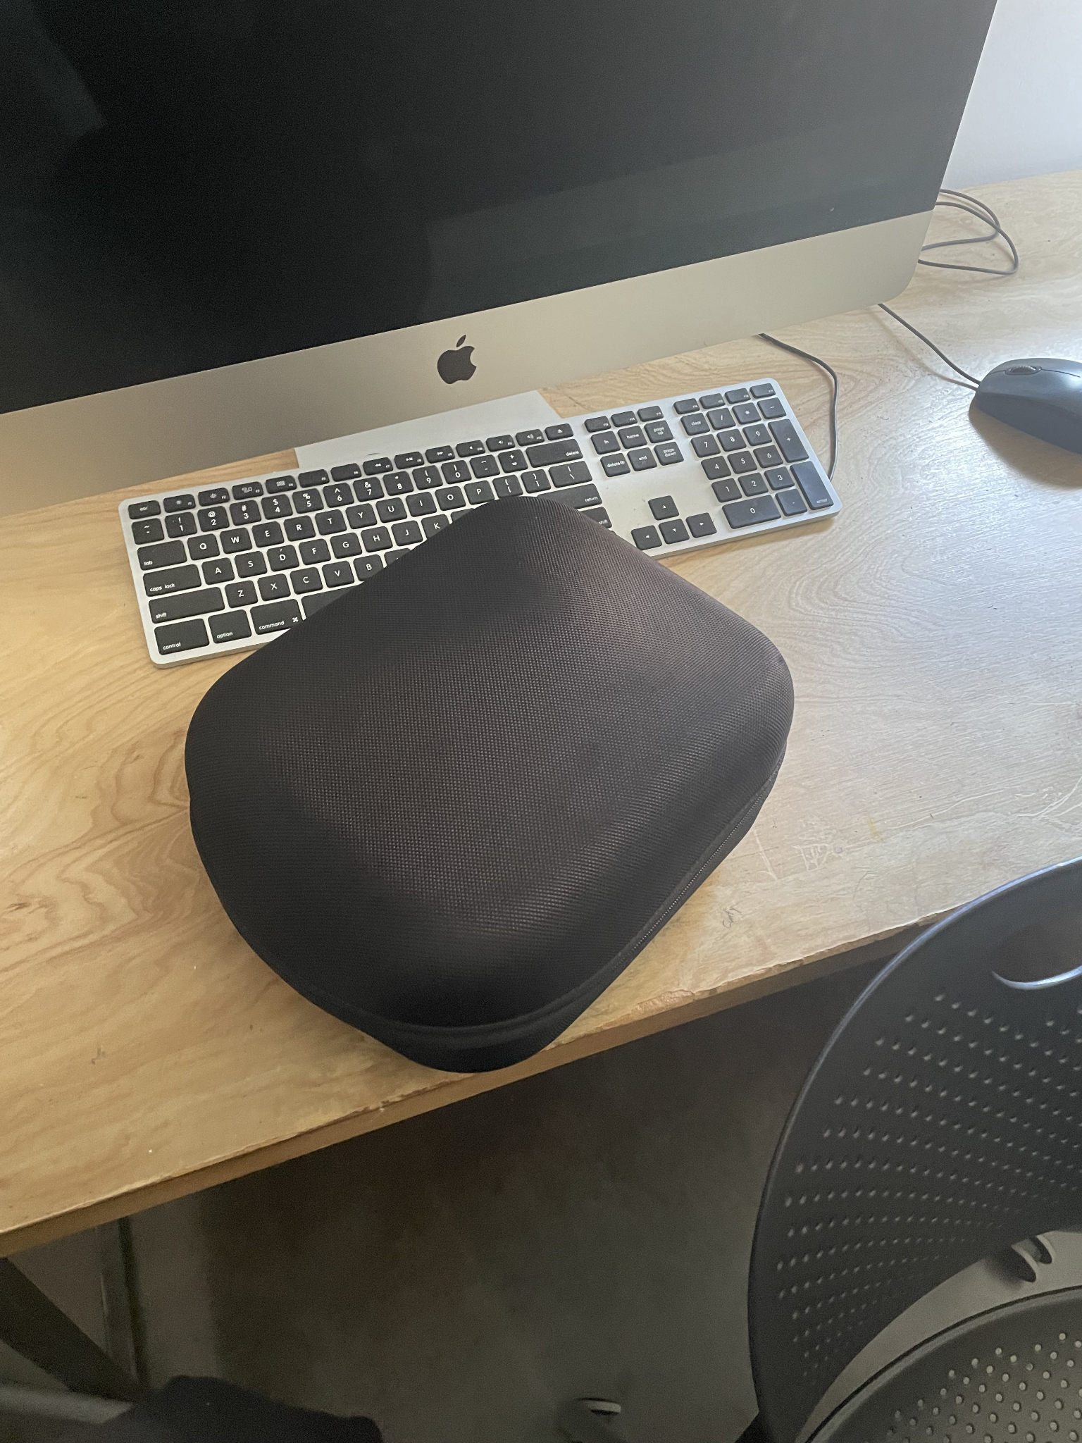

Slide 3

Timeline
Unity Collaboration
Virtual Reality Setup
Colliders, Triggers, Scene Changes, Animation, Buttons Triggers
Spring Break
Midterm Presentations
Lighting & Sounds
Optimization

Slide 4
Alternate Optimization Guides
Quest - Unity Testing and Performance
Fist Full of Shrimp VR Playlist

Slide 5
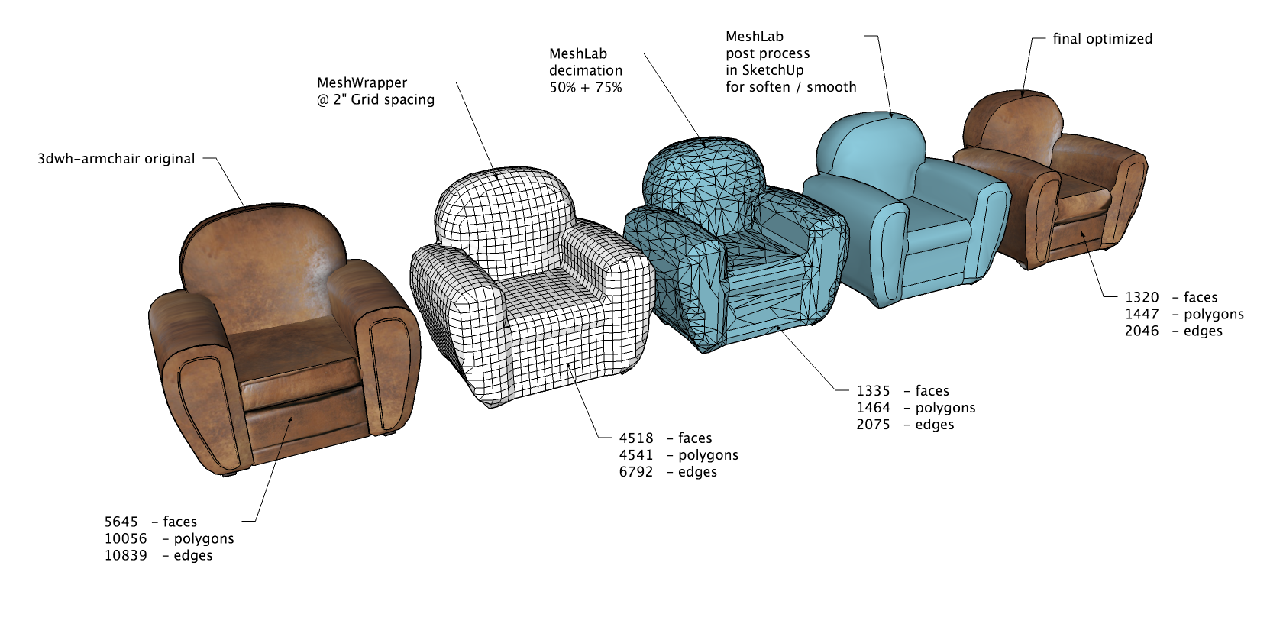
Optimization Definitions - Polycount
Polygons are what make up the geometry of a 3D model. They’re the building blocks of 3D graphic!
Consider balance between detail & performance.

Slide 6
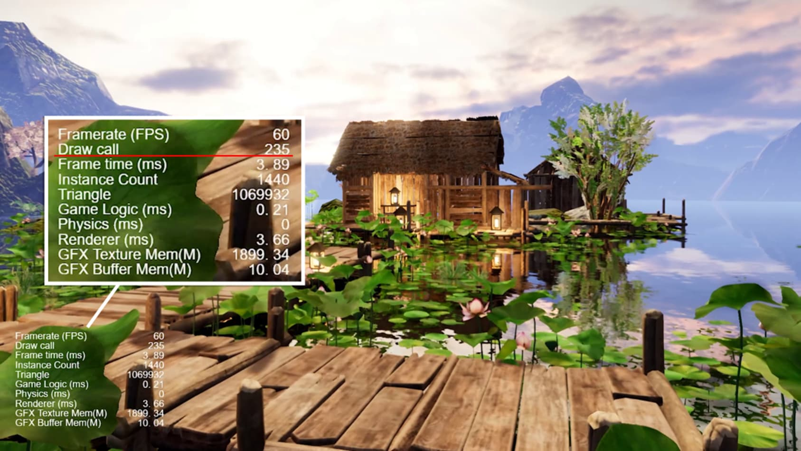
Optimization Definitions - Draw Call
A draw call is a command issued by the CPU to the GPU telling it what to draw and how to draw it (a specific object or set of objects with a particular material or shader.
The higher polycount -> the higher number of draw calls we have to make every frame

Slide 7
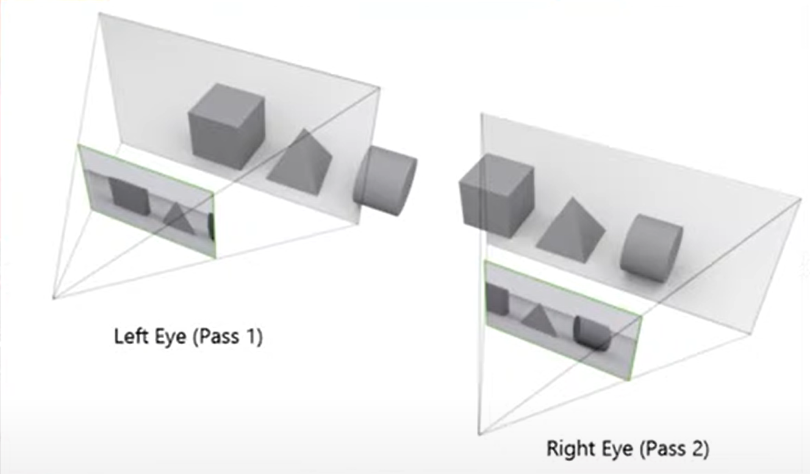
Optimization - Draw Calls in VR
Why do we need to optimize more so for VR?
We have 2 eyes that we are rendering for!
Note: draw calls aren’t 1:1 w/ objects.
Meshes x Materials = Draw Calls.

Slide 8
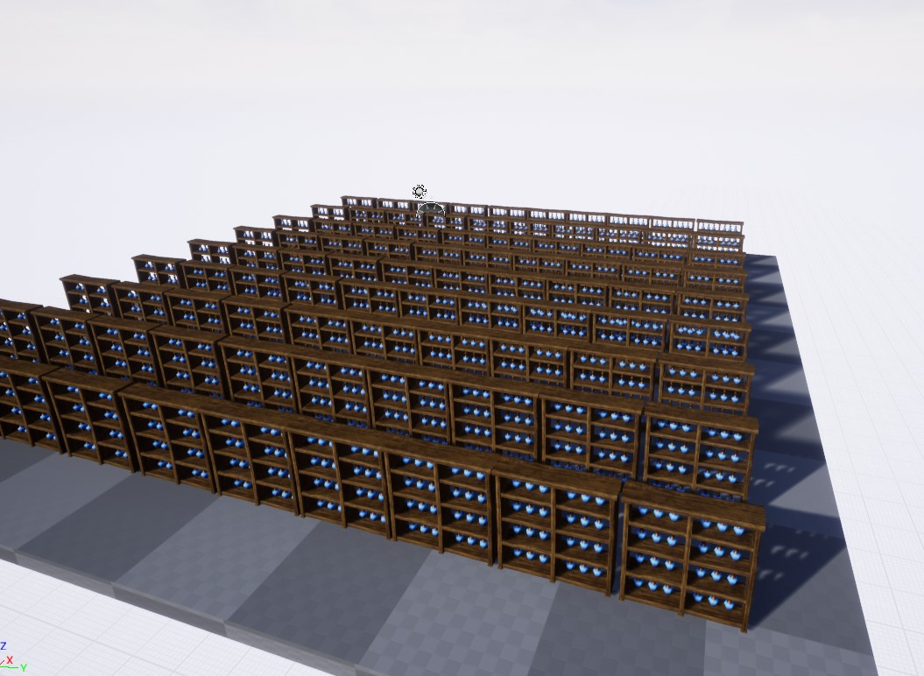
Optimization - Static Batching
If our objects do not move and we can let Unity know that these objects are static. Unity will take all the static objects and make them into a single mesh, creating one draw call
If we mark these bookcases as static, then Unity will refer to these as one draw call.

Slide 9
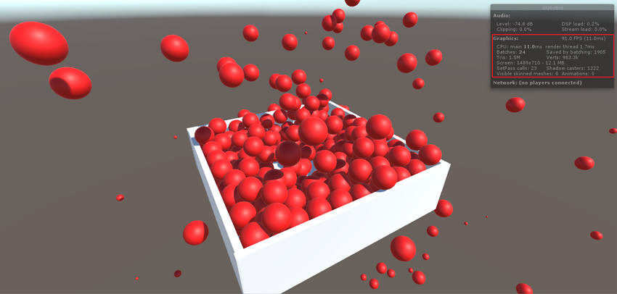
Optimization - Dynamic Batching
Now, how do we do this for objects that move?
Dynamic Batching!
There are some requirements for doing this.
300 vertices
Objects have the same material
Same Scale.
As long as we have Dynamic Batching enabled. Unity will automatically calculate objects that fit the criteria.

Slide 10
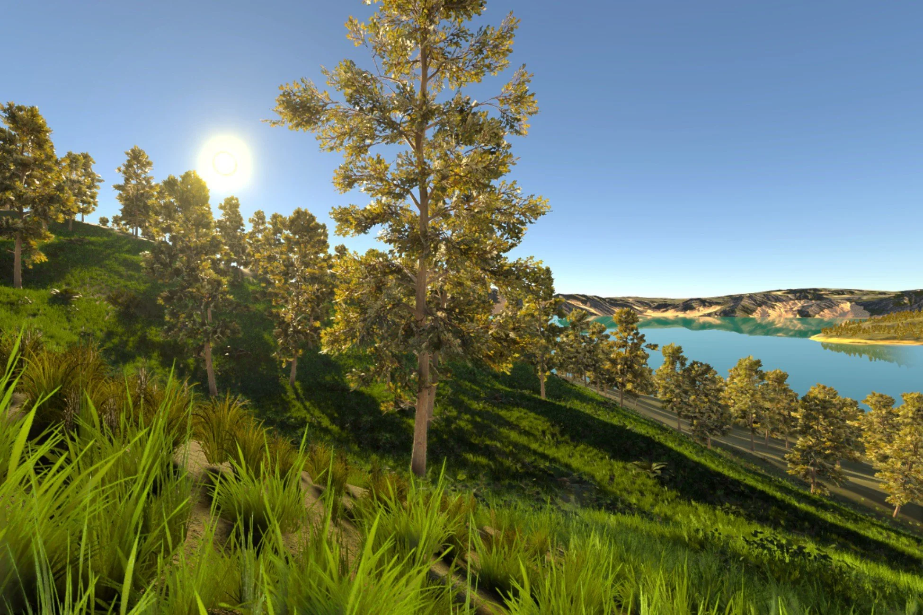
Optimization - GPU Instancing
Use GPU Instancing to draw (or render) multiple copies of the same Mesh at once, using a small number of draw calls. It is useful for drawing objects such as buildings, trees and grass, or other things that appear repeatedly in a Scene.
While these trees are above our 300 vert limit from the previous slide, with GPU instancing we can decrease the number of draw calls!

Slide 11
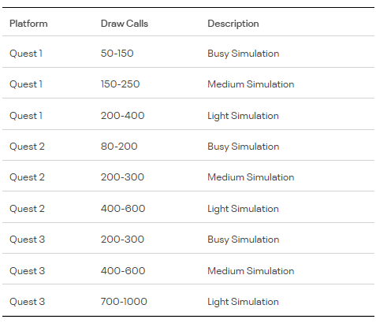
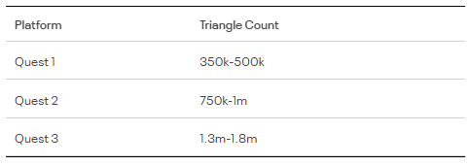
Optimization - Quest Specs
Now that we got this, we can understand some of the differences between using the Quest 3 vs Quest 2. Let’s take a look at the developer documents for preferences.
Testing and Performance Analysis | Oculus Developers

Slide 12
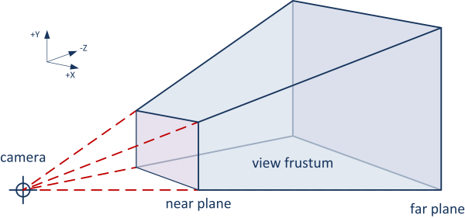

Anatomy of a 3D Camera
Our camera will draw everything contained within our “view frustum”.
We can using “frustum culling” to only render objects that are visible on screen.
“He better not be thinking about frustum culling”
Occlusion
Culling
Unity dev
clipping planes
Note: Unity uses frustum culling by default … so how can we take this a step further?

Slide 13
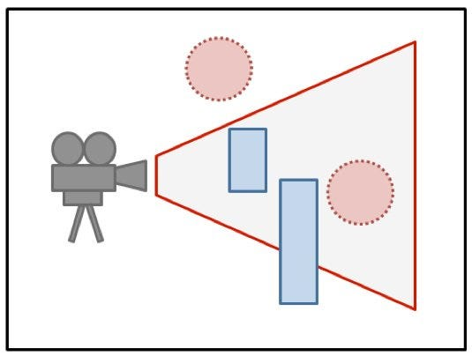
Optimization - Occlusion
occludee
Using Occlusion Culling we can control which objects we want to render out. If an object is blocking (occluder) an object that can’t be seen (occludee), then the occludee won’t be rendered.
occluder

Slide 14

Optimization Takeaways & Reducing Simulation Sickness
When developing a VR experience that you wish to share with others such as an exhibition piece, you must consider using these optimization techniques to reduce dropping frames. If you’re game drops below 60 frames per second then it’s more than likely your user will experience Simulation Sickness.

Slide 15
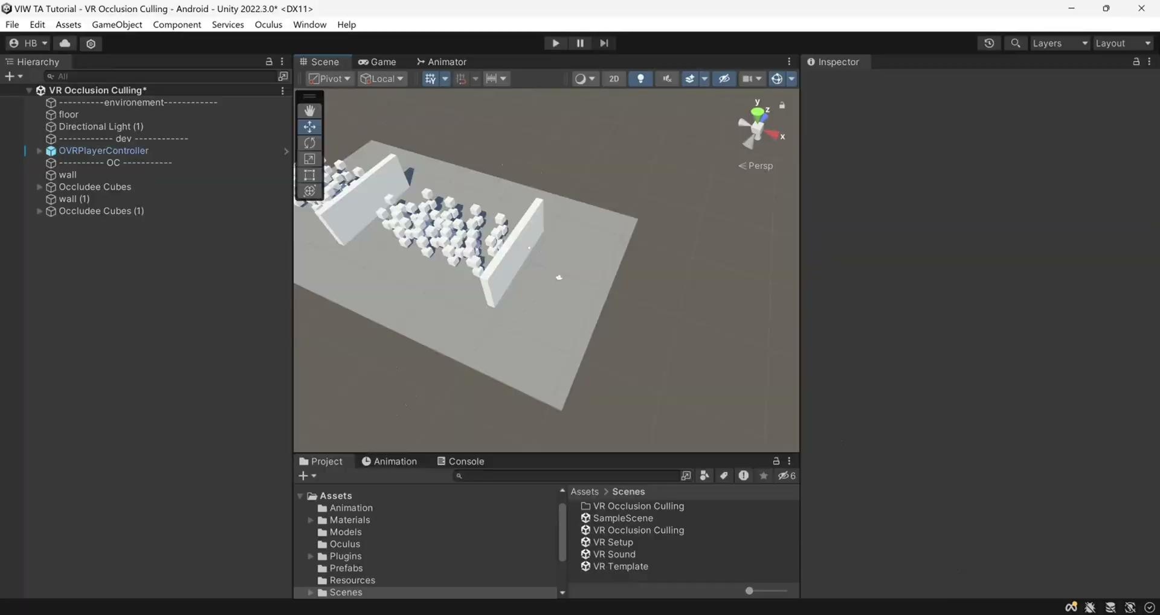
Occlusion Culling Video

